Slide 1
Flight Game Simulator Project
Done by: Adrián García, Hannah Hoang, Arijana Määttä

Slide 2
Introduction
Storyline
Idea & goal of the game
Coding solutions
Database solutions
Demo of the game
Further development ideas

Slide 3
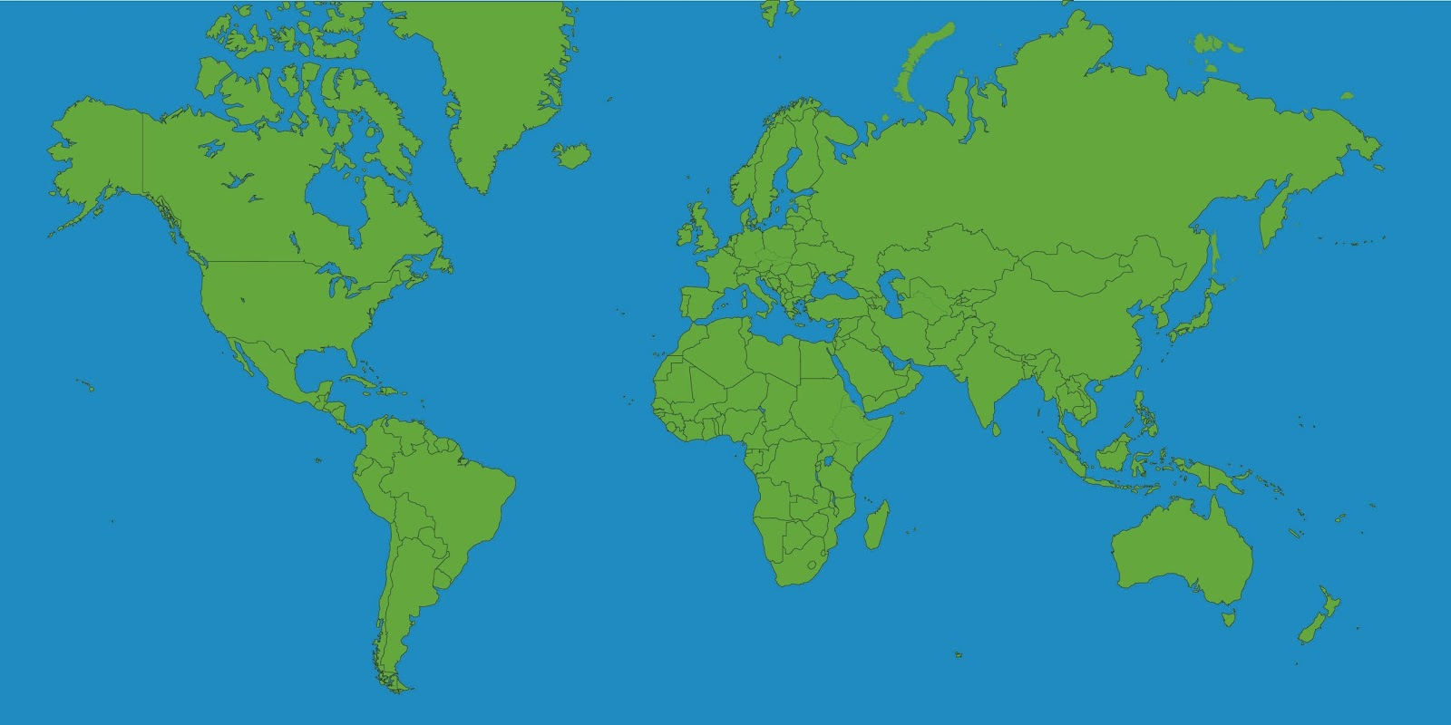
Storyline
Do you believe in Santa Claus?
Trip to Rovaniemi

Slide 4
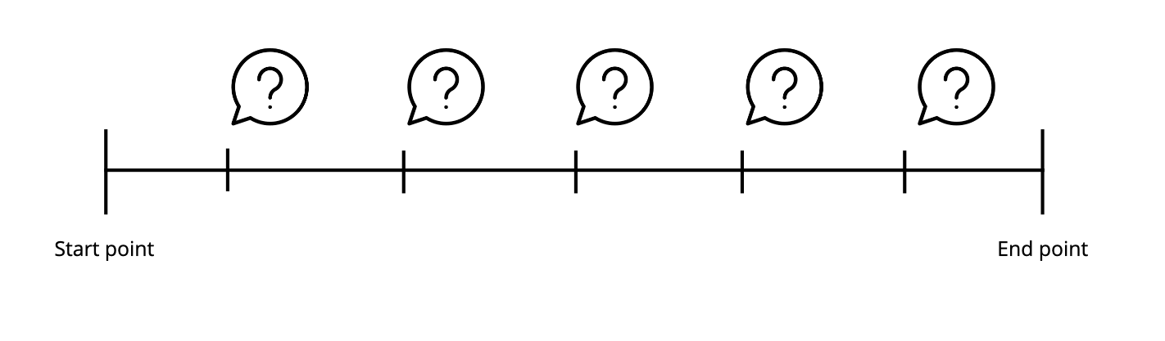
Idea & goal of the game
Start: 5.000 CO2 units.
Budget: 10.000 CO2 units
5 destinations.
Random weather
Collect the score
Game over if score >= 10.000 units

Slide 5

Coding solutions
Problem 1: Random questions and avoid repetition.
Problem 2: Exit the while loop with several conditions.

Slide 6
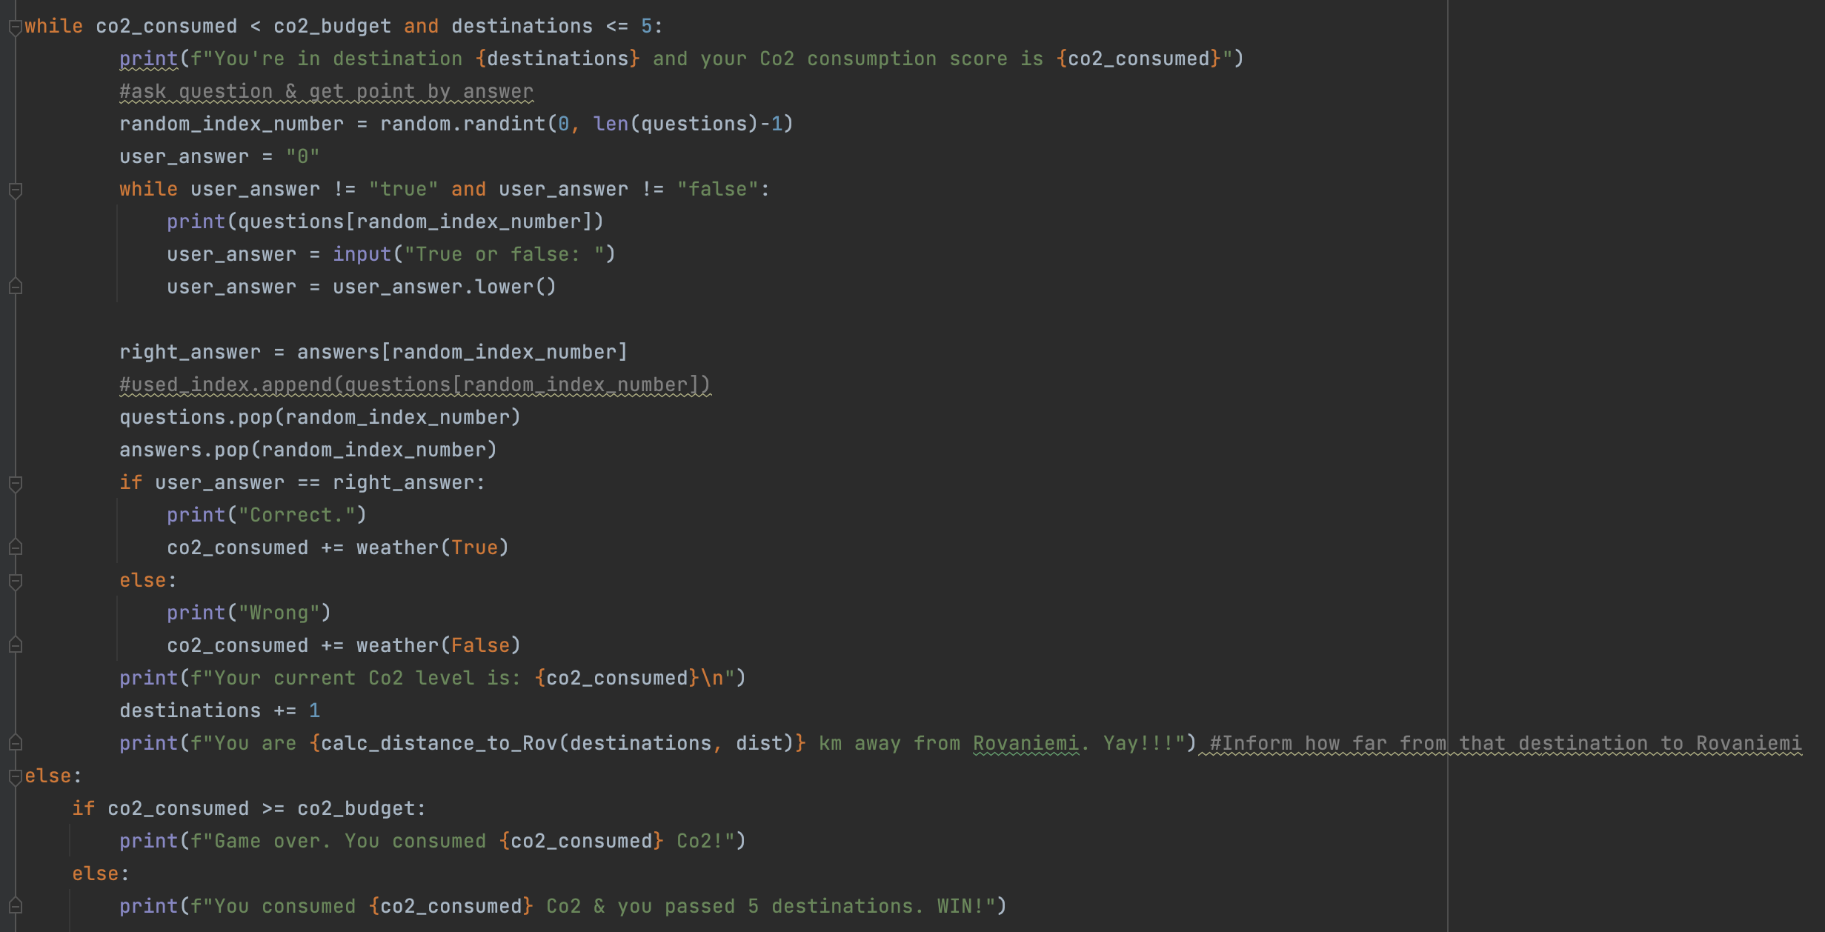
Coding solutions examples

Slide 7

Database solution
”Flight_game”.
Record player score.

Slide 8
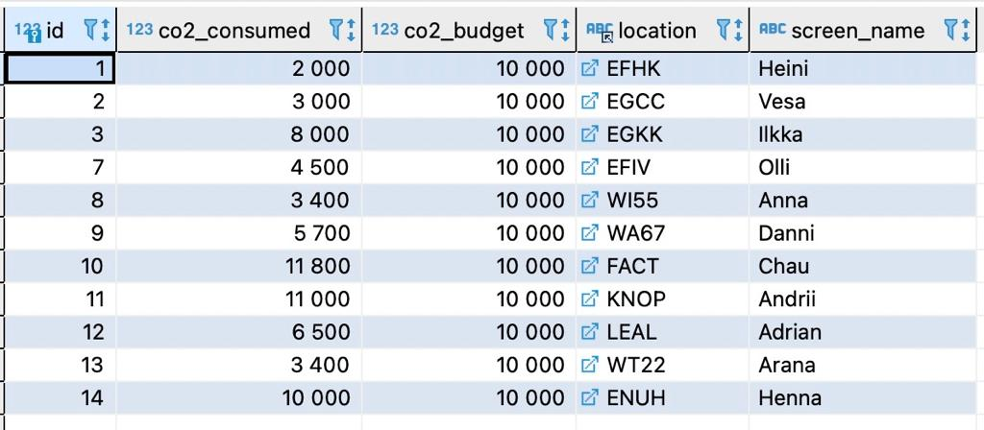
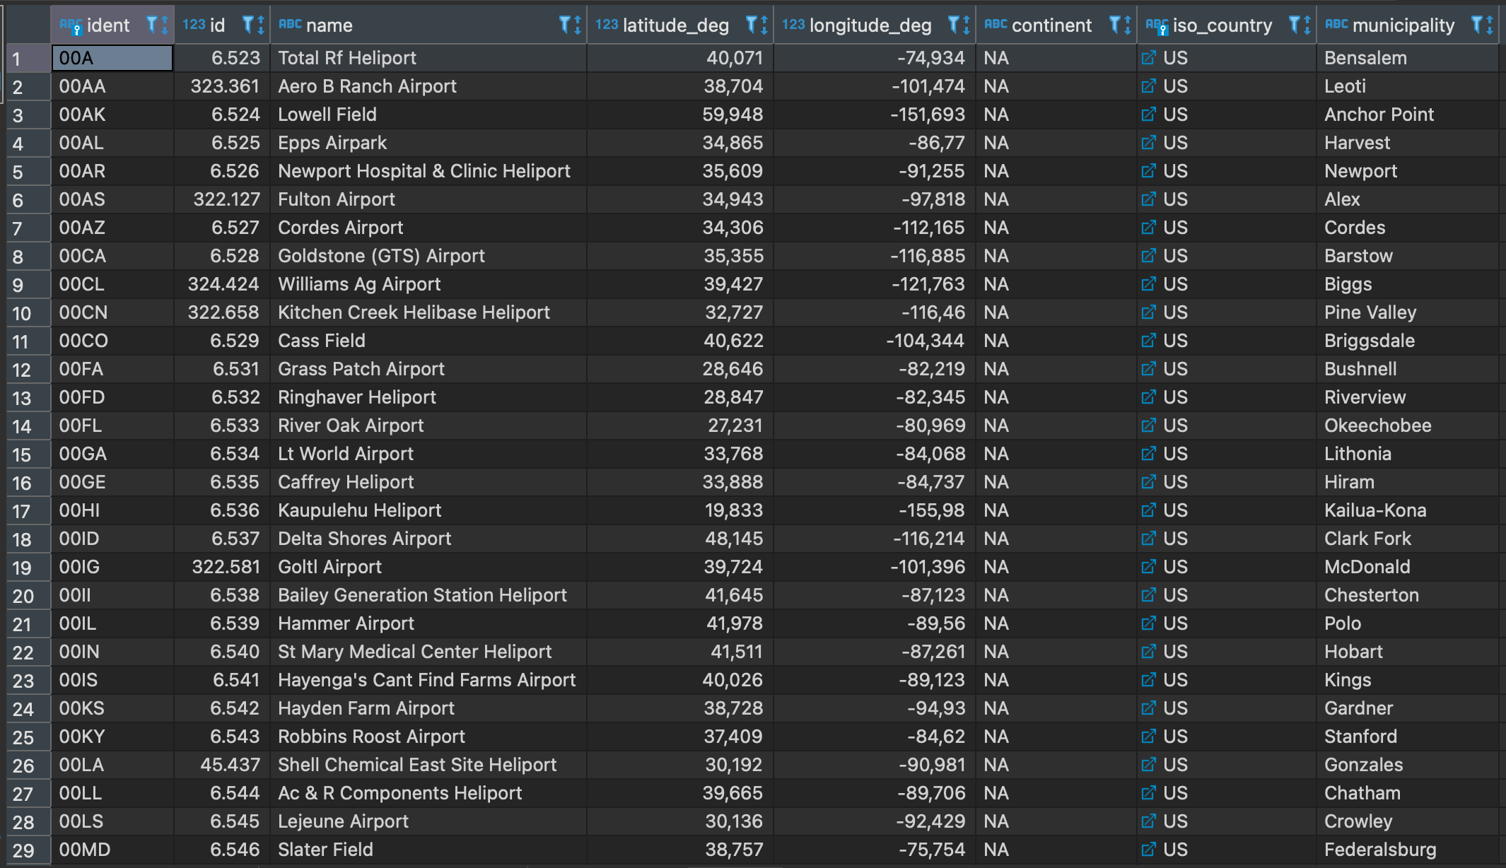
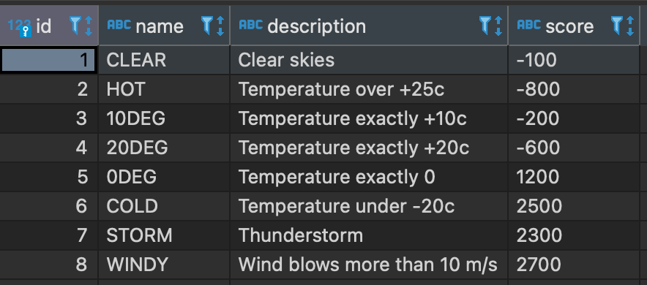
Database solutions examples

Slide 9

Demo of the game
Are you ready to meet Santa Claus?

Slide 10
Further development ideas
More destinations .
Details of the transit airports.
More possibilities when you reach the budget.

